Slide 2
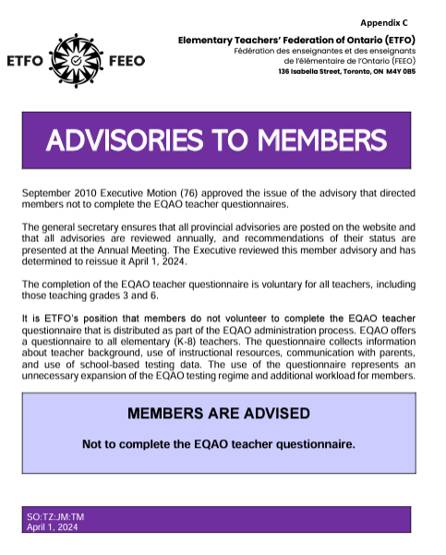
ETFO Advisory
In 2010, ETFO’s provincial Executive issued an advisory to all members to not complete the voluntary questionnaire. This questionnaire represents an unnecessary expansion of the EQAO testing regime and results in additional workload for members.

Slide 3
Relevant in 2024-2025
The ETFO advisory to members not to complete the voluntary EQAO teacher questionnaire is even more relevant today.
EQAO has indicated that it is leveraging information from teacher questionnaires to investigate decreasing EQAO scores.

Slide 4
Transferring Accountability
Should the government link decreasing EQAO scores with results from the teacher questionnaire, teachers would be blamed. This transfers accountability away from the government for its systematic underfunding of public education to teachers.

Slide 5
ETFO Secure
The ETFO member advisory regarding not completing the EQAO teacher questionnaire and any other ETFO advisories can be found on ETFO Secure.
All ETFO members are invited to register for ETFO secure at members.etfo.ca. You will need your ETFO ID to register.

Slide 6
End EQAO
To read more about the systemic reasons why EQAO must end, please read the Voice article “End EQAO.”
Learn more about ETFO’s position on EQAO on our website.

